Slide 1


CMR TECHNICAL CAMPUS UGC (Autonomous) Kandlakoya, Medchal Road, Hyd-501401
Department of Computer Science and Engineering
A
Major Project On
Detection of Cyber Bullying on Social Media using Machine Learning
BATCH NO: 03
GROUP MEMBERS :
207R1A0562 B. Sri Priya
207R1A0573 CH. Santosh Kumar
207R1A0575 D. Surya Teja
UNDER THE GUIDANCE OF:
Saba Sultana
(Assistant Professor)

Slide 2
CONTENTS
Abstract
Existing System
Disadvantages in Existing System
Proposed System
Advantages of Proposed System
Hardware and Software Requirements
Novelty
Architechture
Modules
UML Diagrams
Sample code
Results
Future Scope
Conclusion

Slide 3
ABSTRACT
Cyberbullying is an activity of sending threatening messages to insult person. To prevent cyber victimization from the activity is challenging.
It is a misuse of technology advantage to bully a person. Cyberbully and its impact have occurred around the world and now the number of cases are increasing.
Cyberbullying detection is very important because the online information is too large so it is not possible to be tracked by humans.
This project enhanced the Naïve Bayes classifier for extracting the words and examining loaded pattern clustering. The purpose of this research is to construct a classification model with optimal accuracy in identifying.

Slide 4
EXISTING SYSTEM
An existing system for cyberbullying detection on social media leverages machine learning to automatically identify and address abusive behavior.
It collects and preprocesses data from platforms like Twitter and Facebook, extracting relevant features for model training.
Trained on labeled data, the system employs algorithms like SVM and Naive Bayes to classify content as cyberbullying or non-cyberbullying.
Upon deployment, it continuously monitors social media activity, flagging instances of cyberbullying for review by platform administrators. Regular updates and user-friendly interfaces ensure effective detection and mitigation of cyberbullying incidents.

Slide 5
DISADVANTAGES
Limited Coverage
Bias and Fairness
Scalability Issues
Adaptability
Privacy Concerns

Slide 6
PROPOSED SYSTEM
The proposed system for cyberbullying detection on social media utilizes advanced machine learning techniques.
Here we have used an algorithm called navies bayes which can handled large amount of data.
These techniques will preprocess data, extract relevant features, and train models for accurate classification.
It incorporates real-time monitoring to promptly flag potential instances of cyberbullying for review by platform administrators.
With a user-friendly interface, users can report incidents, facilitating continuous improvement and fostering a safer online environment.

Slide 7
ADVANTAGES
Enhanced Accuracy
Real-Time Monitoring
Improved Scalability
Adaptability to Evolving Tactics
User-Friendly Interface

Slide 8
NOVELTY
The novelty of the proposed system lies in its integration of cutting-edge machine learning algorithms and svm and navies bayes techniques tailored specifically for cyberbullying detection on social media platforms.
Unlike existing systems, the proposed system incorporates advanced features such as real-time monitoring, scalable processing capabilities, and adaptability to evolving cyberbullying tactics.
Additionally, the system's user-friendly interface and proactive reporting mechanisms enhance user engagement and collaboration, fostering a safer and more inclusive online environment.

Slide 9
HARDWARE & SOFTWARE REQUIREMENTS
Hardware Requirements:
Processor : Pentium IV or higher
RAM : 256 MB
Hard Disk : 512MB
Software Requirements:
Operating system : Windows 7 Ultimate.
Coding Language : Python.
Front-End : HTML, CSS
Back-End : Django-ORM
Data Base : MySQL (WAMP Server).

Slide 10
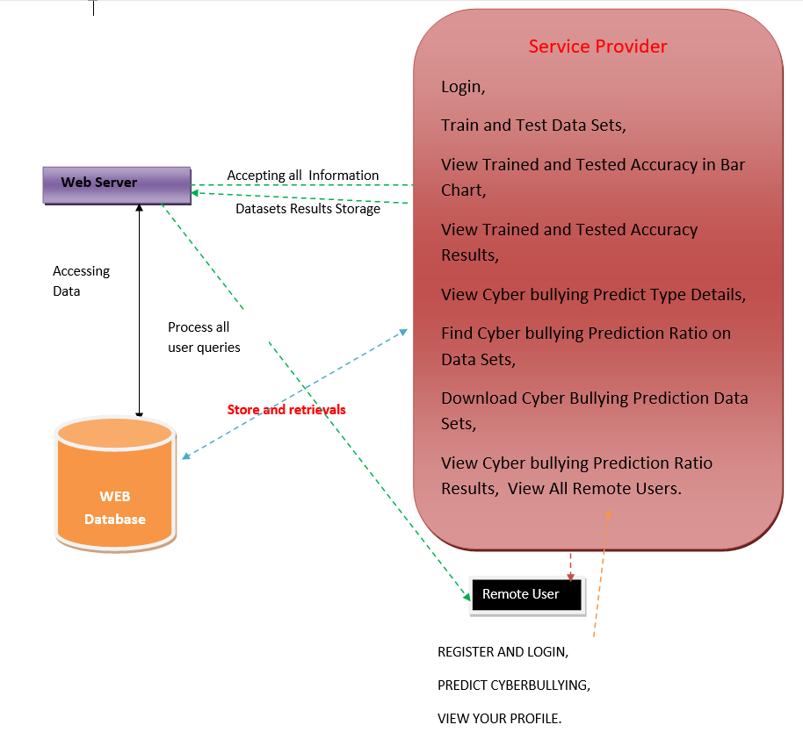
ARCHITECHTURE

Slide 11
MODULES
Service Provider
In this module, the Service Provider has to login by using valid user name and password. After login successful he can do some operations such as Login, Train and Test Data Sets, View Trained and Tested Accuracy in Bar Chart, View Trained and Tested Accuracy Results, View Cyber bullying Predict Type Details, Find Cyber bullying Prediction Ratio on Data Sets, Download Cyber Bullying Prediction Data Sets, View Cyber bullying Prediction Ratio Results, View All Remote Users.
b) View and Authorize Users
In this module, the admin can view the list of users who all registered. In this, the admin can view the user’s details such as, user name, email, address and admin authorizes the users.

Slide 12
c) Remote User
In this module, there are n numbers of users are present. User should register before doing any operations. Once user registers, their details will be stored to the database. After registration successful, he has to login by using authorized user name and password. Once Login is successful user will do some operations like REGISTER AND LOGIN, PREDICT CYBERBULLYING, VIEW YOUR PROFILE.

Slide 13
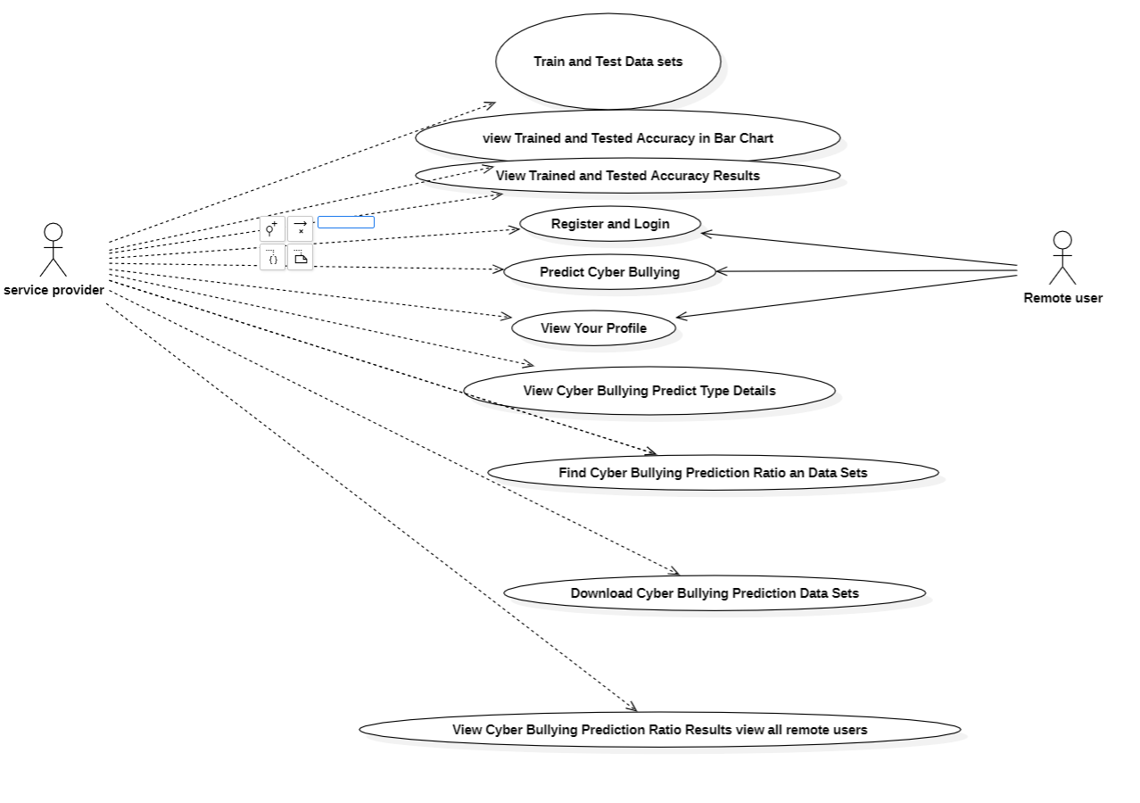
UML DIAGRAMS
1. USECASE DIAGRAM :

Slide 14
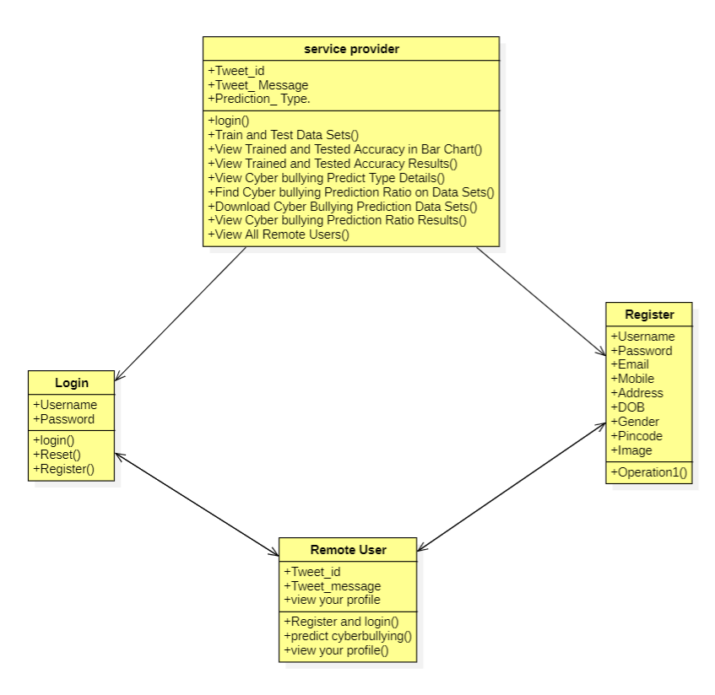
2. CLASS DIAGRAM :

Slide 15
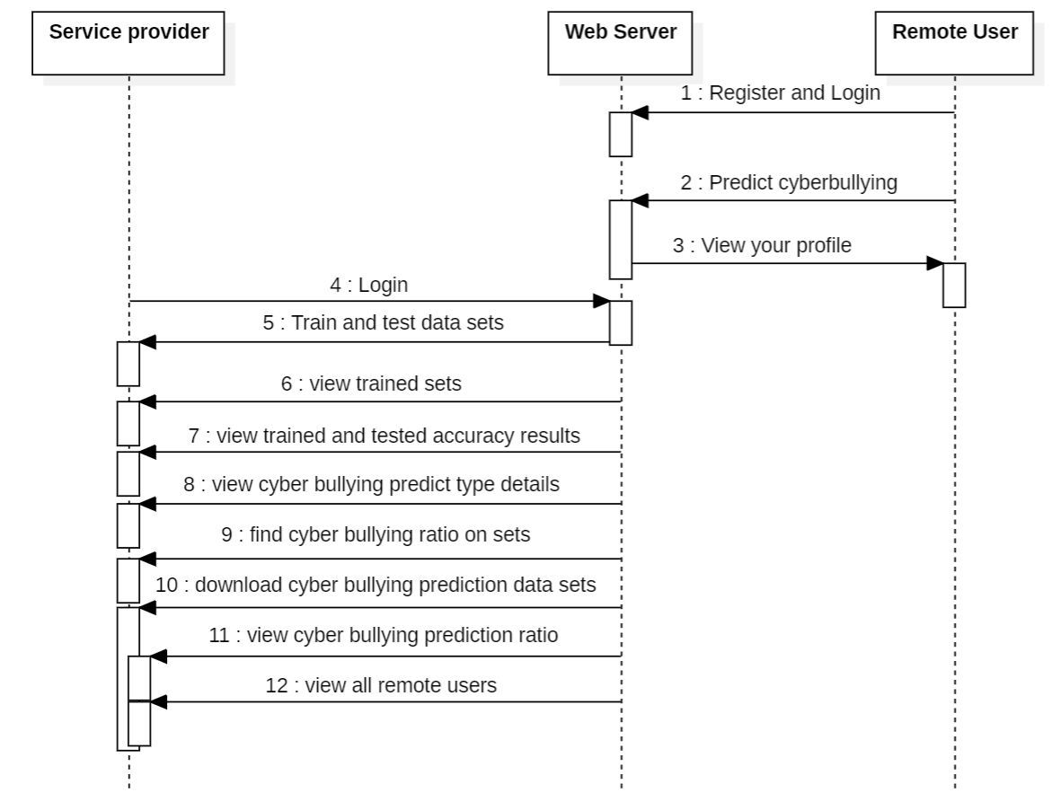
3. SEQUENCE DIAGRAM :

Slide 16
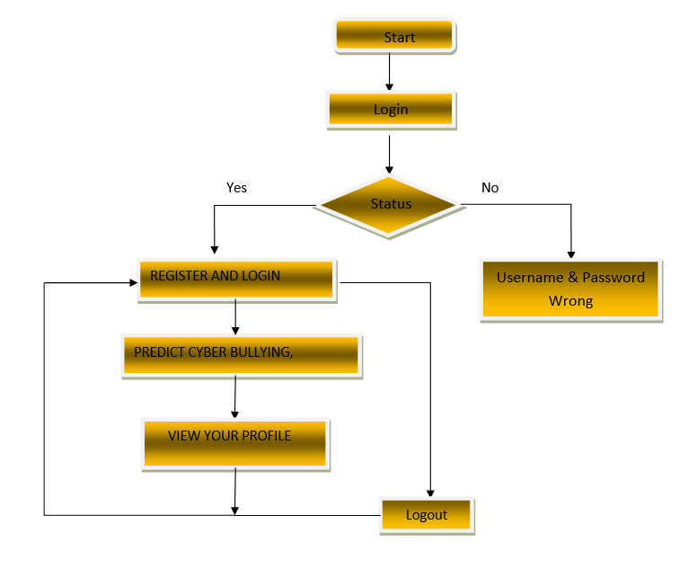
4. ACTIVITY DIAGRAM :
a). remote user

Slide 17
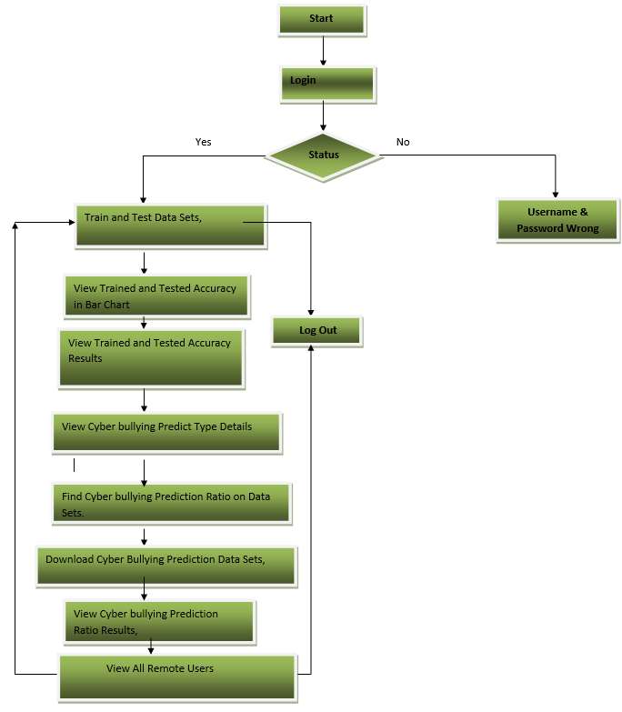
5. ACTIVITY DIAGRAM :
b). Service provider

Slide 18
SAMPLE CODE
def login(request): if request.method == "POST" and 'submit1' in request.POST: username = request.POST.get('username')
password = request.POST.get('password')
try:
enter = ClientRegister_Model.objects.get(username=username,password=password)
request.session["userid"] = enter.id return redirect('Search_DataSets')
except:
pass return render(request,'RUser/login.html’)
def Register1(request): if request.method == "POST":
username = request.POST.get('username')
email = request.POST.get('email')
password = request.POST.get('password')
phoneno = request.POST.get('phoneno')
country = request.POST.get('country')
state = request.POST.get('state')
city = request.POST.get('city')

Slide 19
ClientRegister_Model.objects.create(username=username, email=email, password=password, phoneno=phoneno, country=country, state=state, city=city) return render(request, 'RUser/Register1.html')
else:
return render(request,'RUser/Register1.html')
review_data = [Tweet_Message]
vector1 = count_vect.transform(review_data).toarray()
predict_text = lin_clf.predict(vector1)
pred = str(predict_text).replace("[", "")
pred1 = pred.replace("]", "")
prediction = int(pred1)
if prediction == 0:
val = 'Non Offensive or Non Cyberbullying'
elif prediction == 1:
val = 'Offensive or Cyberbullying'
Tweet_Prediction_model.objects.create(Tweet_Message=Tweet_Message,Prediction_Type=val)
return render(request, 'RUser/Search_DataSets.html',{'objs': val})
return render(request, 'RUser/Search_DataSets.html')

Slide 20

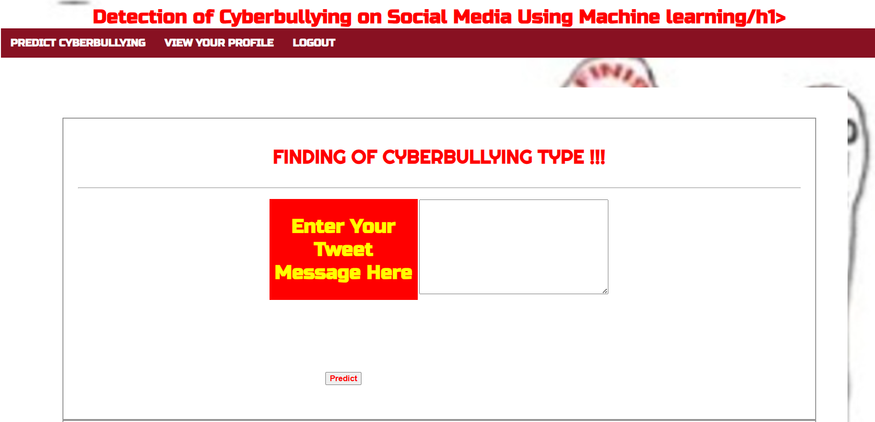
RESULTS

Slide 21

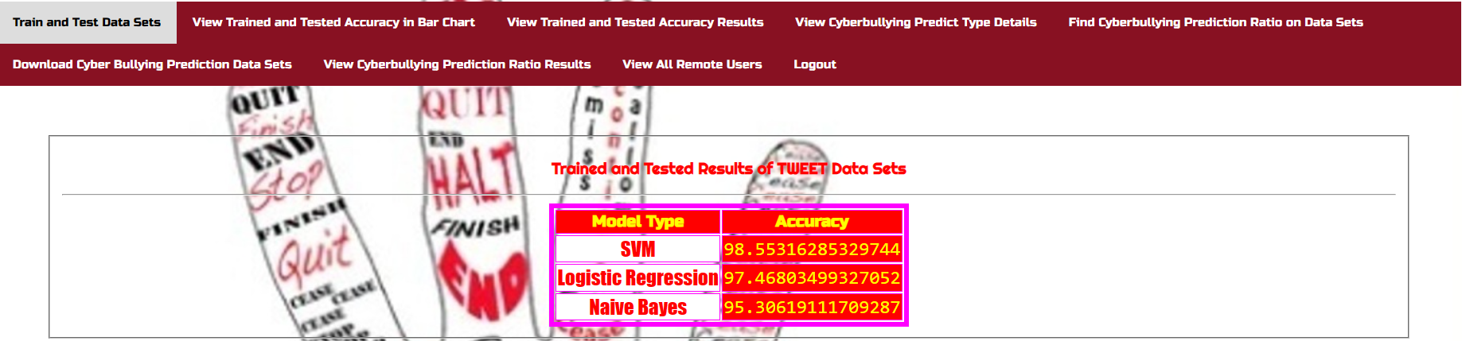
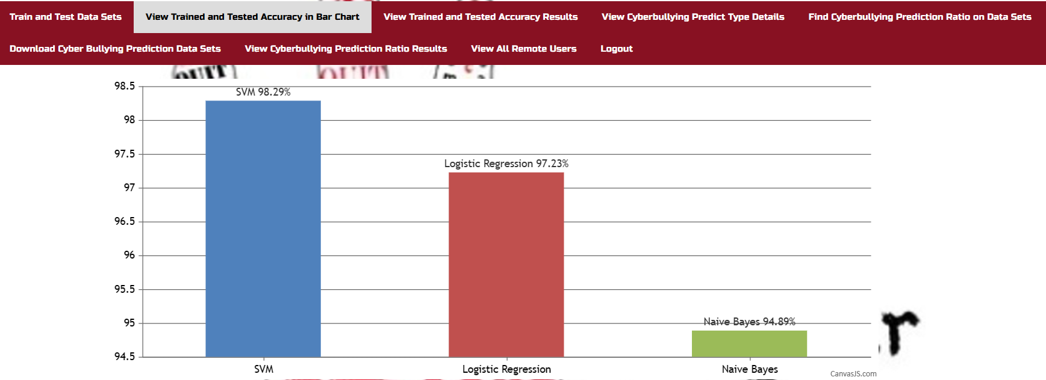

Slide 22
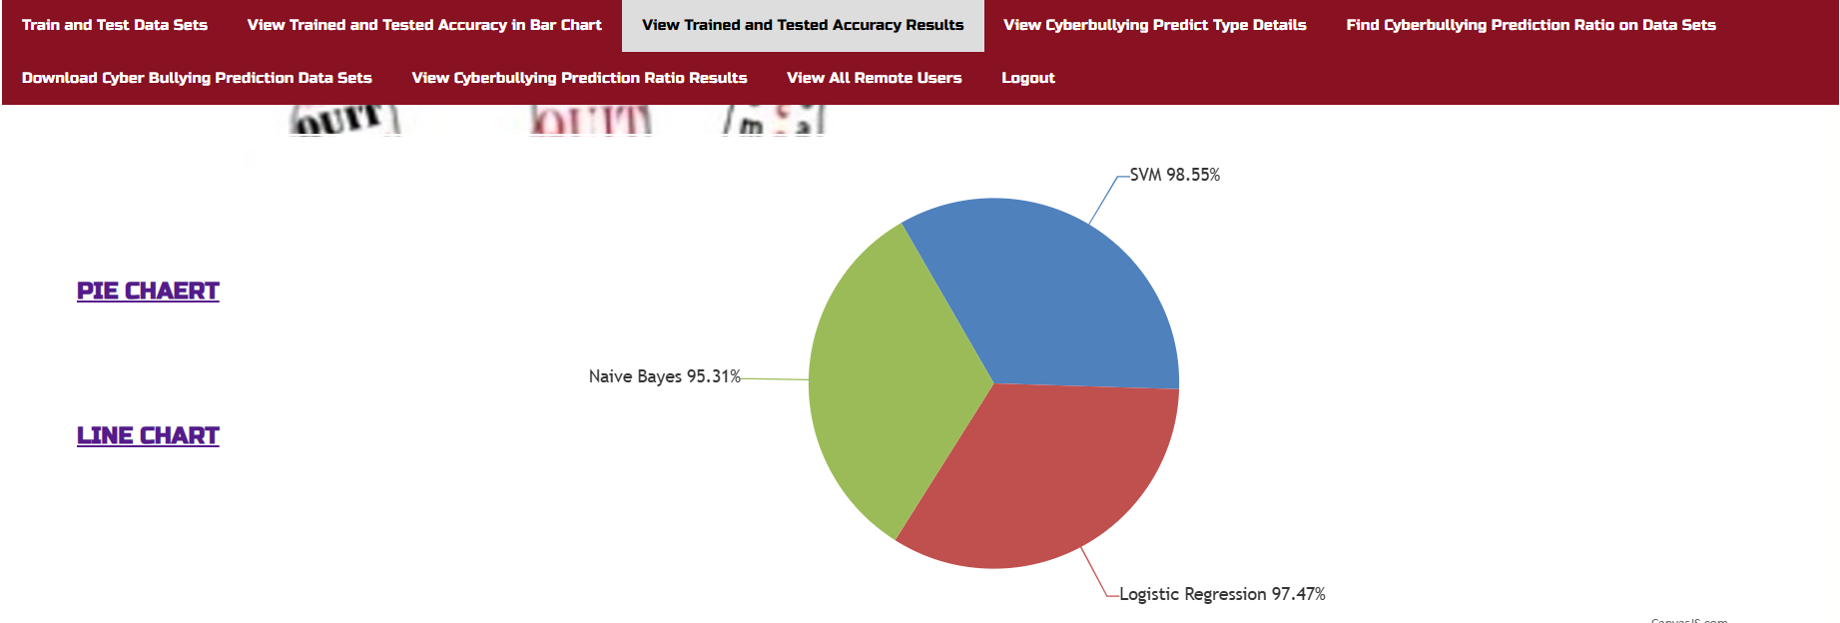
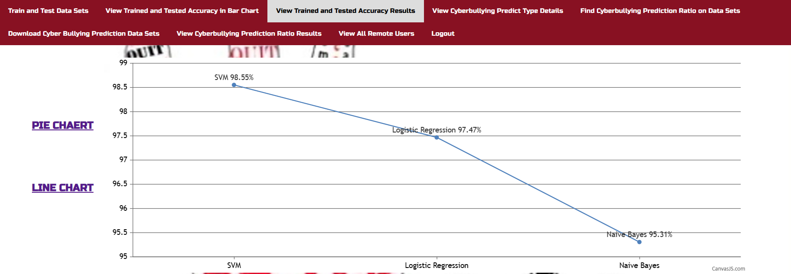
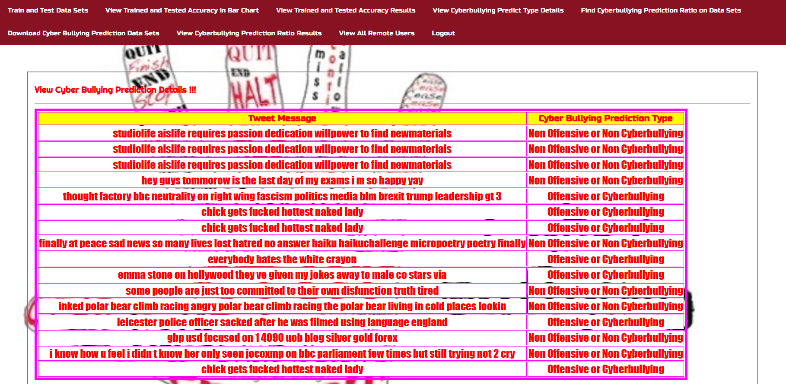

Slide 23
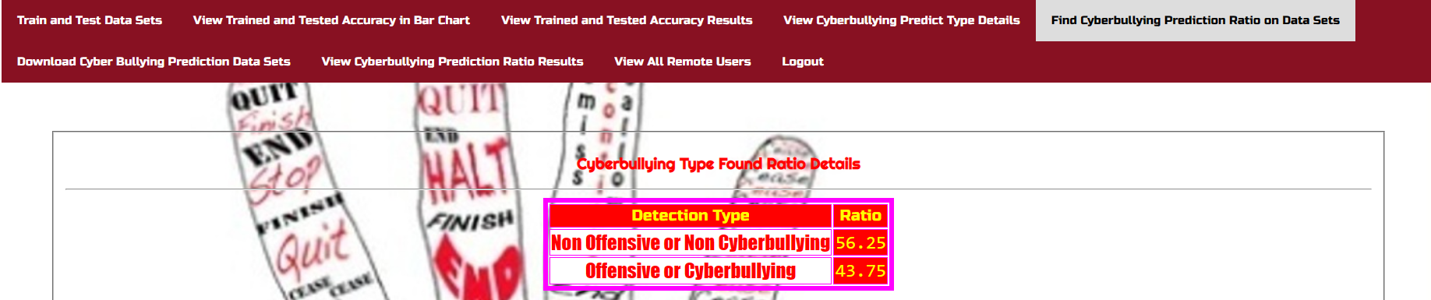
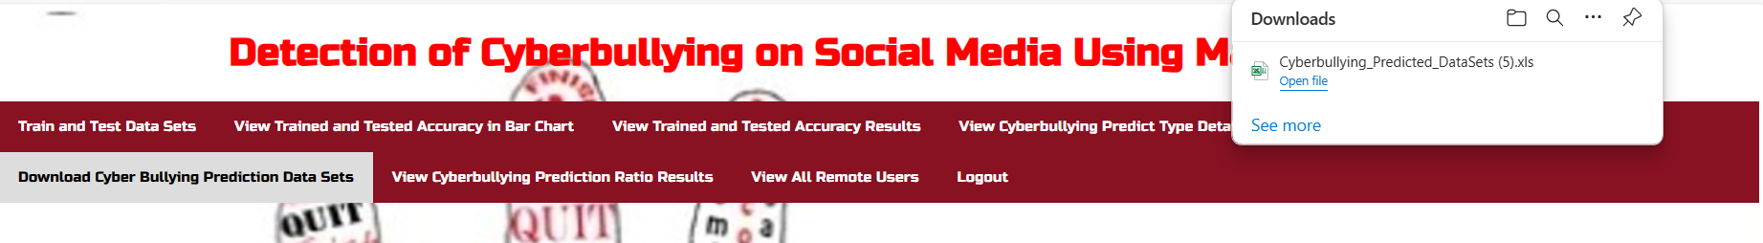
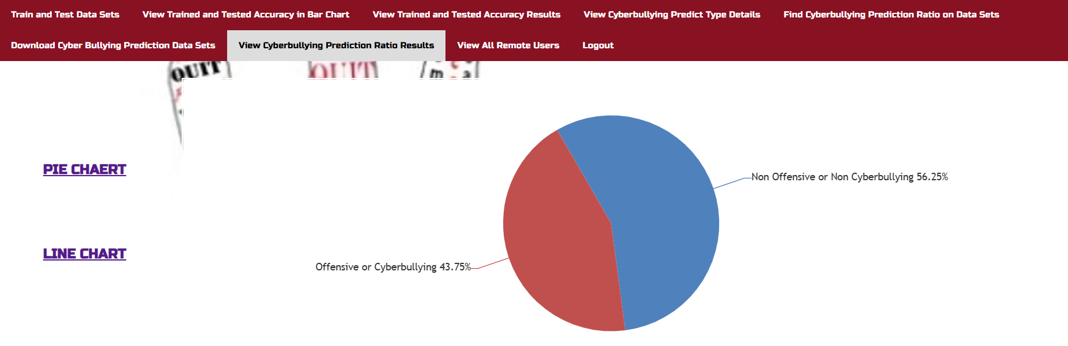
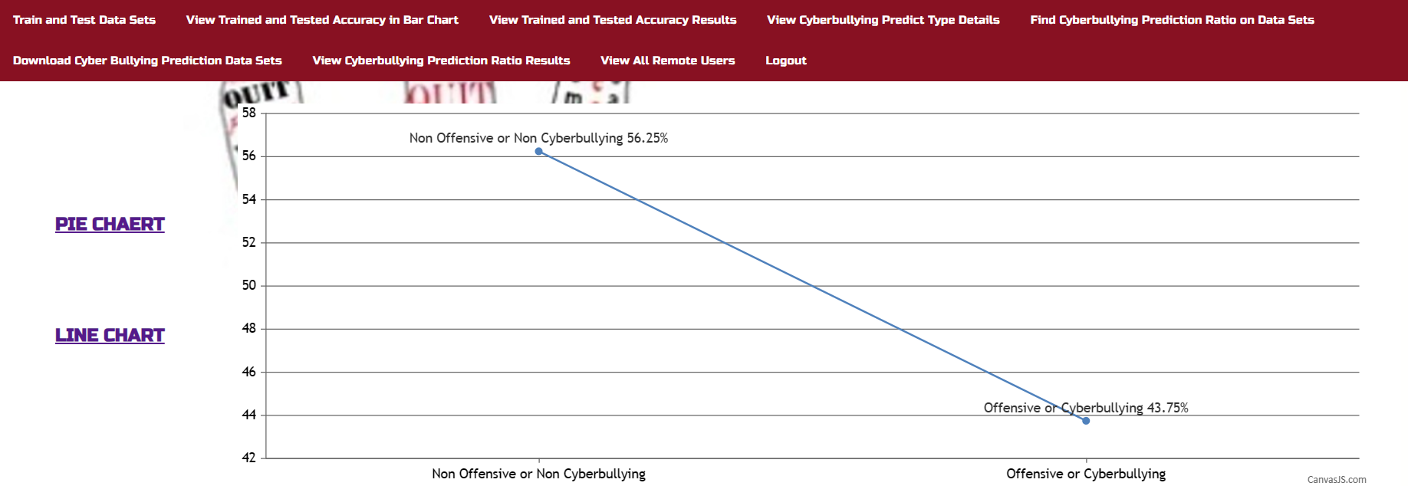

Slide 24
FUTURE SCOPE
Cyberbullying, a pervasive issue online, leads to serious consequences like suicides and depression, highlighting the crucial need for its control.
This paper proposes an architecture for cyberbullying detection, focusing on hate speech data from Twitter and personal attacks on Wikipedia.
SVM and Navies bayes techniques coupled with basic Machine Learning algorithms achieve over 90% accuracy in detecting hate speech, facilitated by the presence of detectable profanity.

Slide 25
CONCLUSION
Cyberbullying, a pervasive issue online, leads to serious consequences like suicides and depression, highlighting the crucial need for its control.
This paper proposes an architecture for cyberbullying detection, focusing on hate speech data from Twitter and personal attacks on Wikipedia.
SVM and Navies bayes techniques coupled with basic Machine Learning algorithms achieve over 90% accuracy in detecting hate speech, facilitated by the presence of detectable profanity.

